Slide 1

Documentation is Evil.
Is it?

Slide 2

Well, it turns out we have bigger enemies.
TECH DEBT

Slide 3
Game Tactics:
We party with the “small enemy” to defeat the Boss
( and, surprise, a friendship is born )

Slide 4
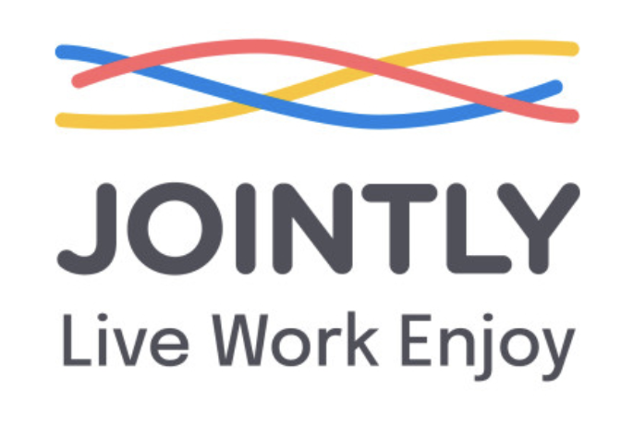
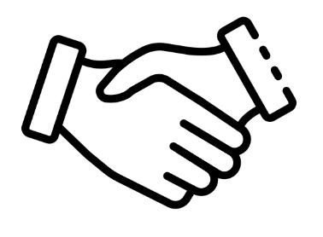

SPONSOR ALERT!

Slide 5
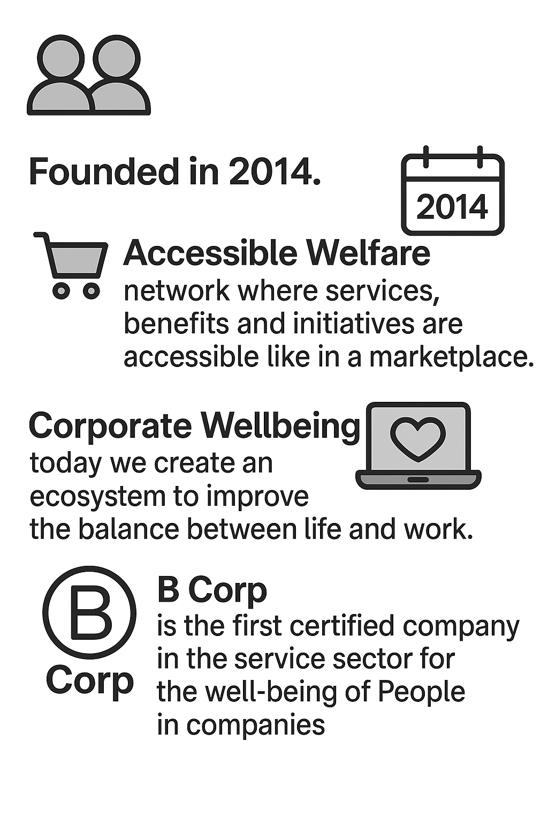
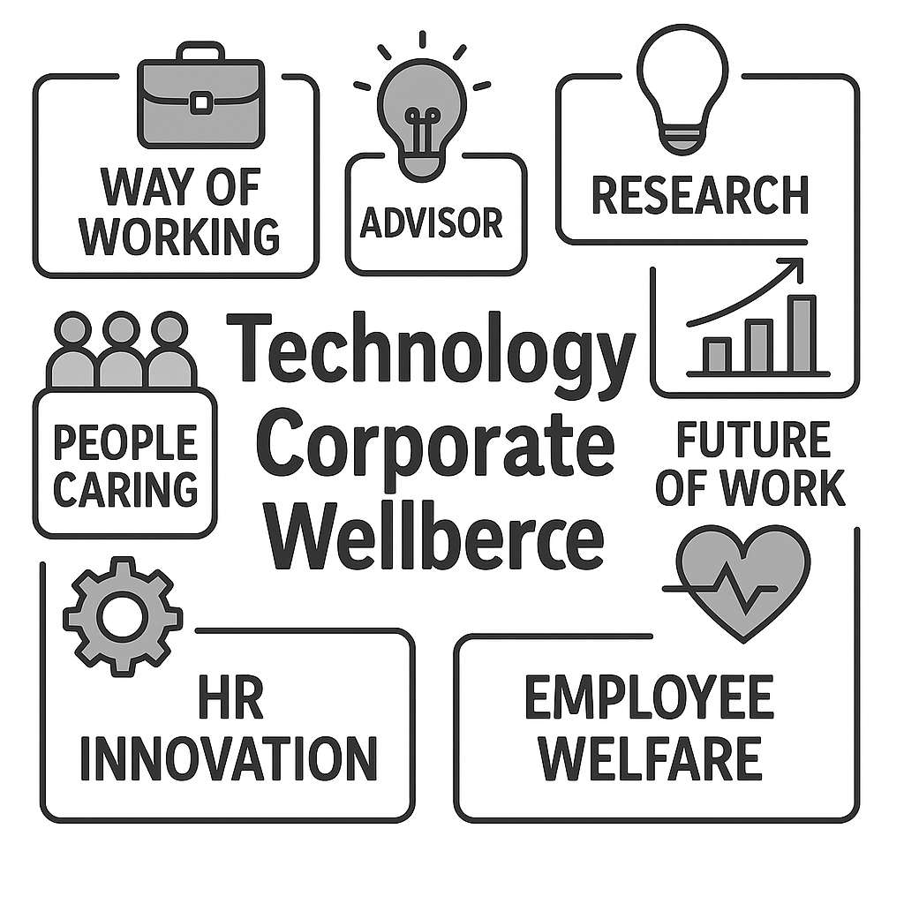
Who we are (and what we do)

Slide 6
What is Corporate Wellbeing
Everyone is talking about it, no one really knows how to define it properly
Jointly is working with other institutions to bring clarity and direction

Slide 7
Four enablers to define Wellbeing
Governance
True difference in impact is in the strategic coherence and in the company capability in integrating wellbeing in its own culture and managerial vision.
This is how our platform comes in the game.
Impact
Measurement
Listening
Communication

Slide 8
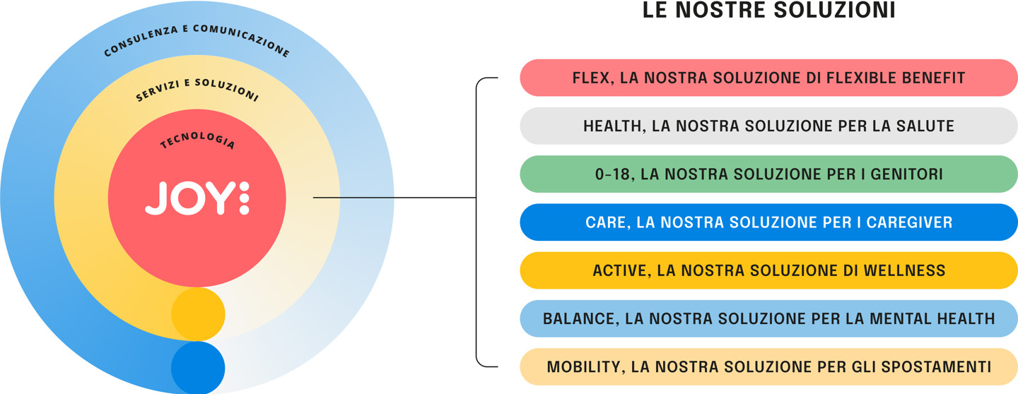
JOY, our Platform for Corporate Wellbeing

Slide 9
What is Technical Debt

Slide 10
It works!
But, please don’t touch it.
(well, this is VERY likely debt!)

Slide 11
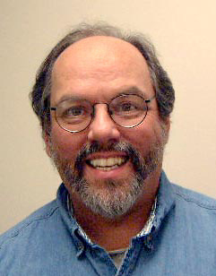
A bit like Finance
“If we failed to make our program align with what we then understood to be the proper way to think about our financial objects, then we were going to continue to stumble on that disagreement which is like paying interest on a loan.”
Tech Debt is similar to financial debt: you are borrowing time to write code quickly but, if you don’t repay it, you are going to see interests: bug, complexity, slow systems.

Slide 12
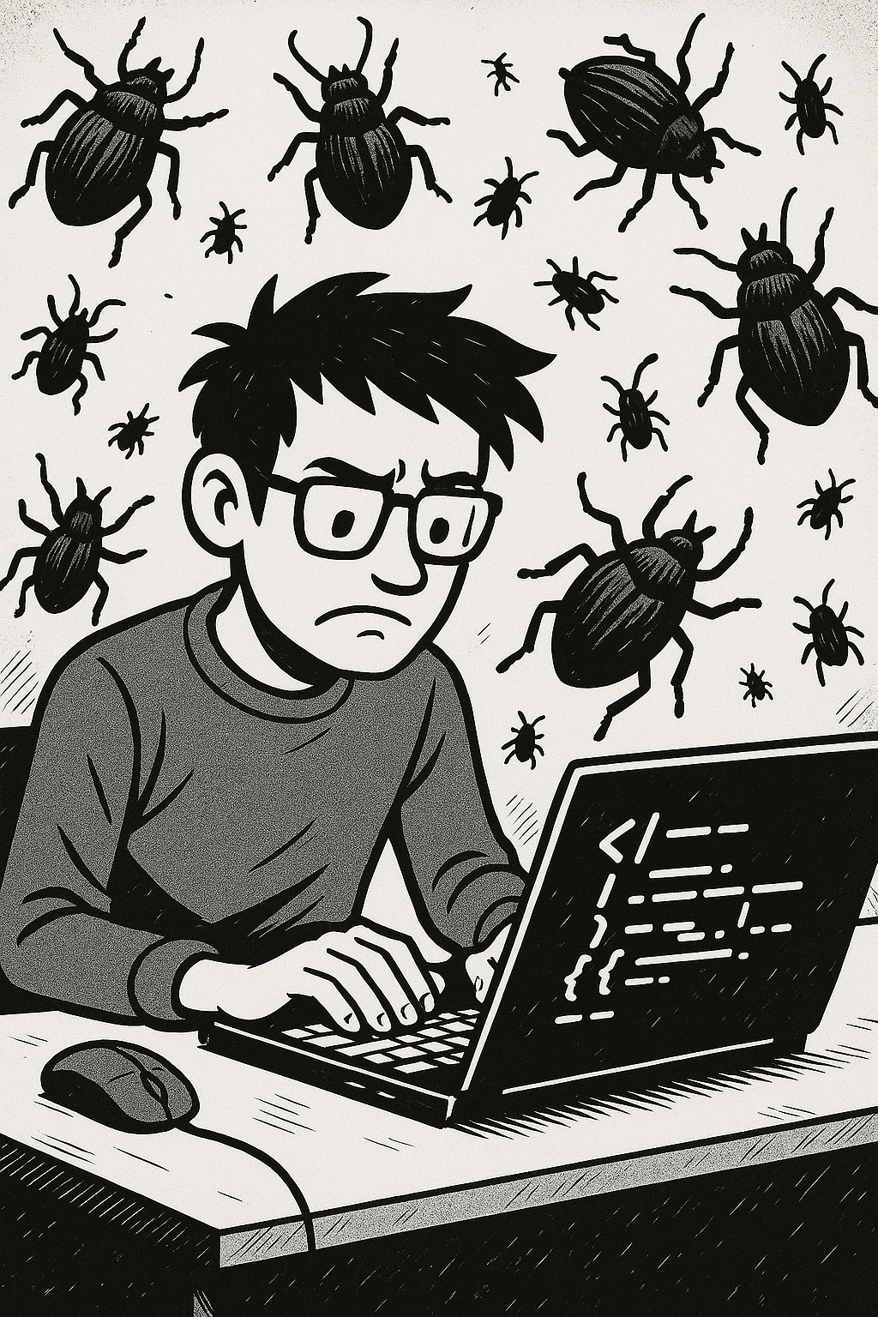
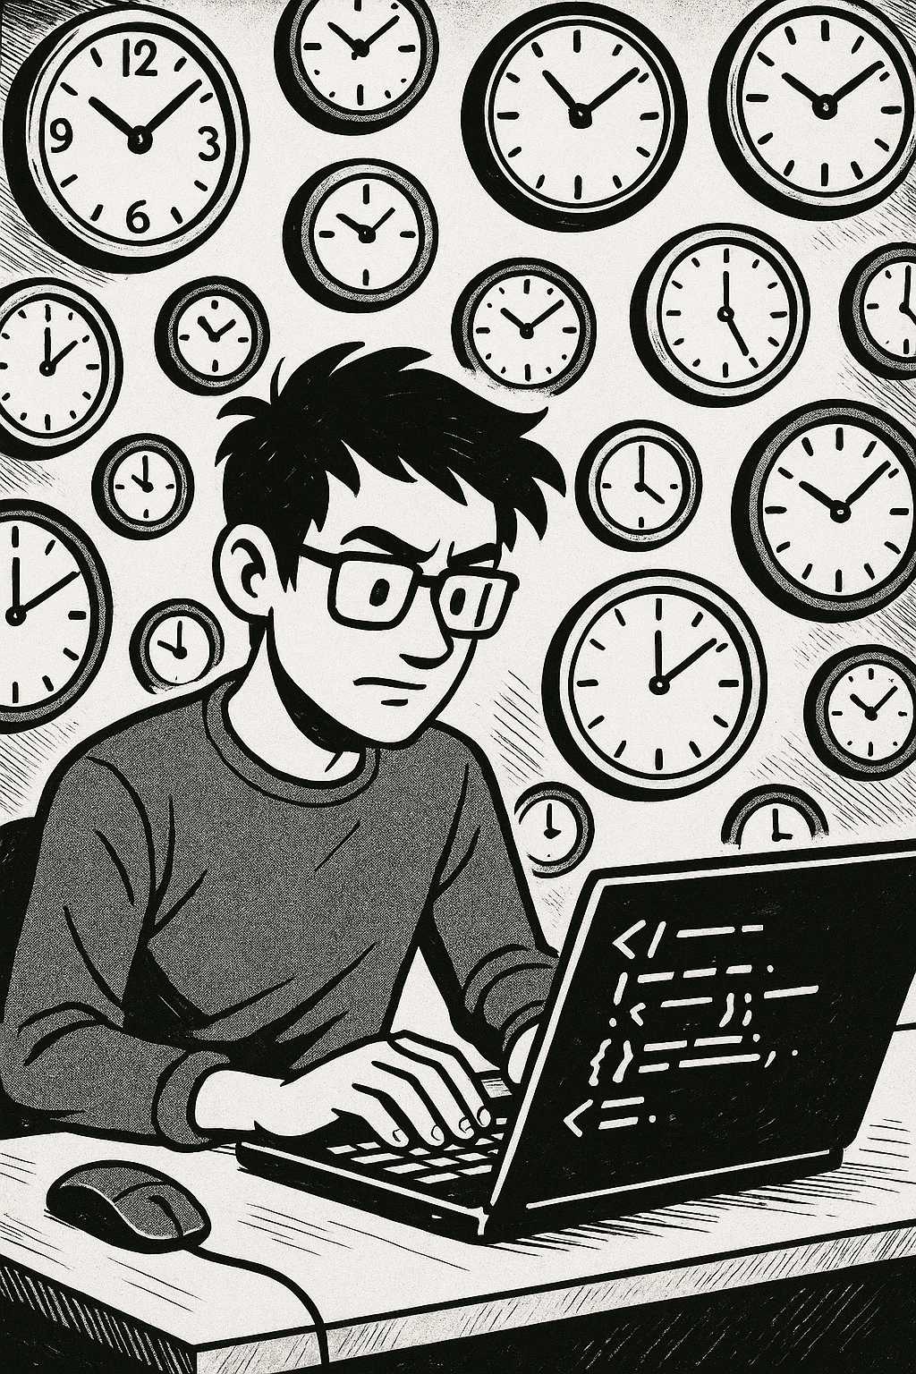
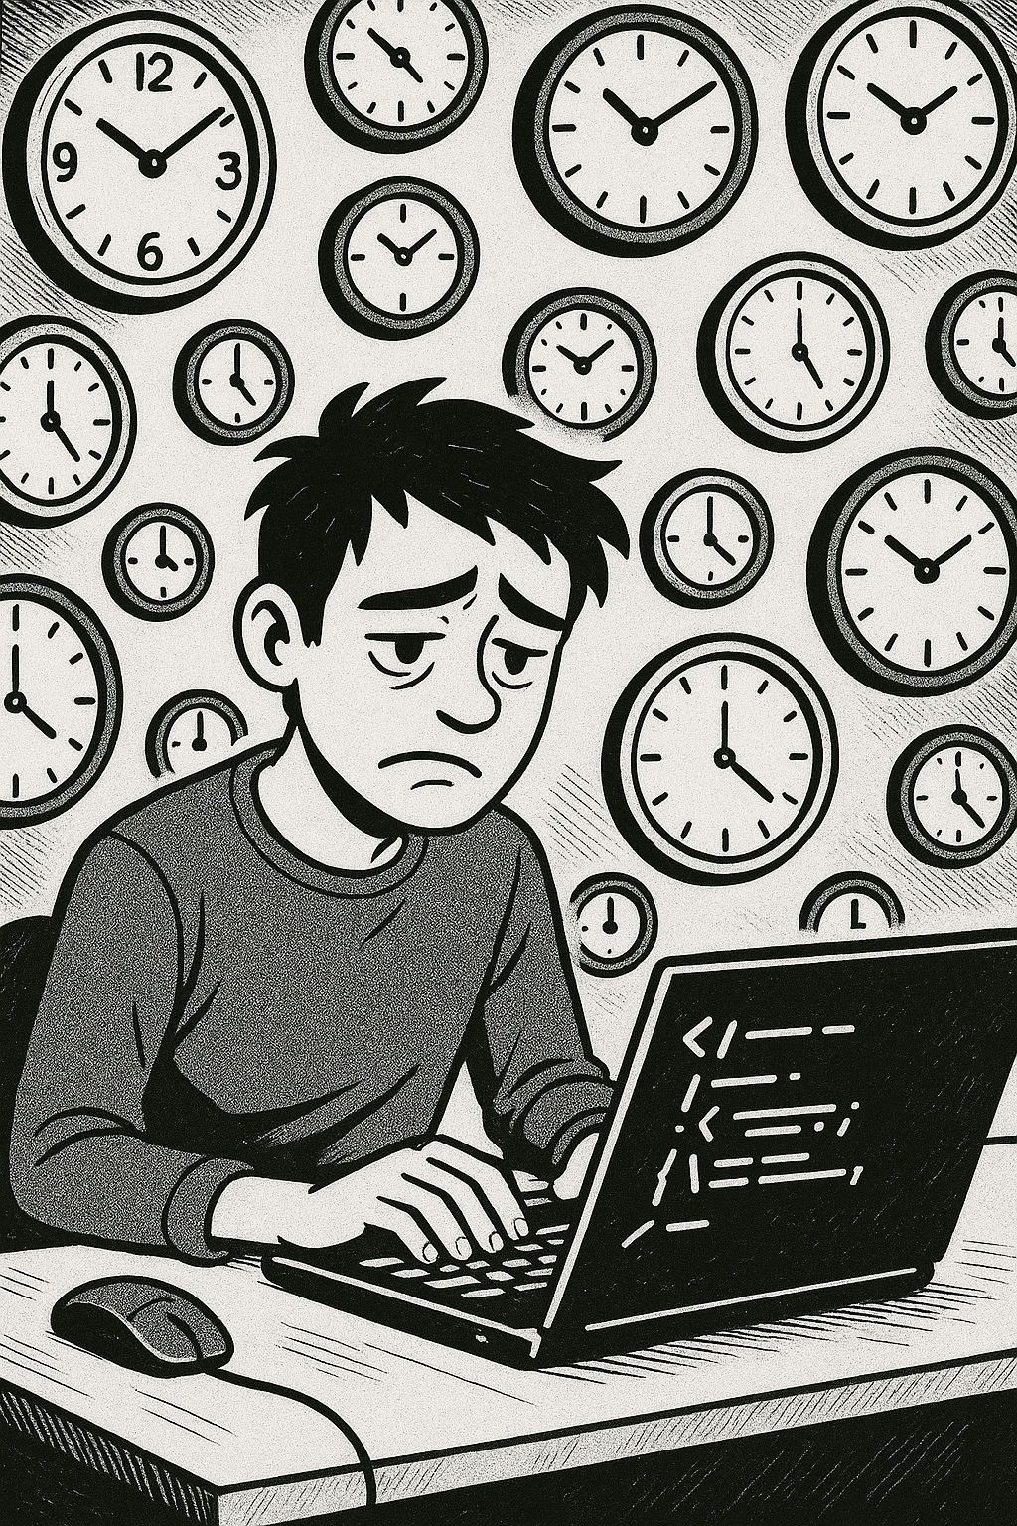
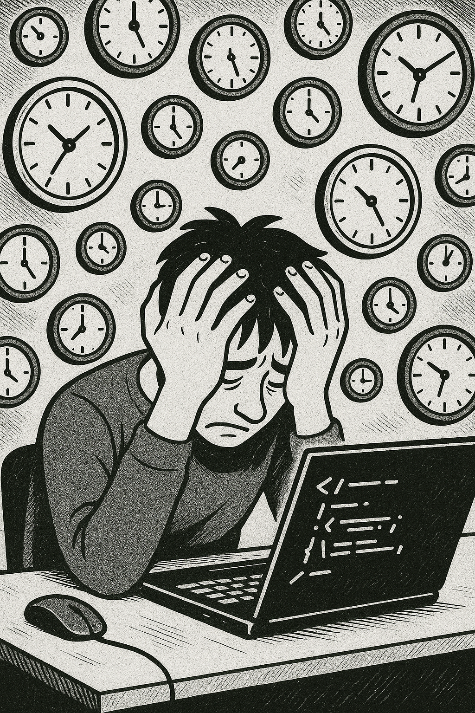
Consequences of Debt
Bugs
(a lot of them)
Slow Development
Lack of Confidence
Team
Frustration
Tech debt doesn’t kill project in one day - it destroys them from the inside, until innovation becomes simply impossible.

Slide 13
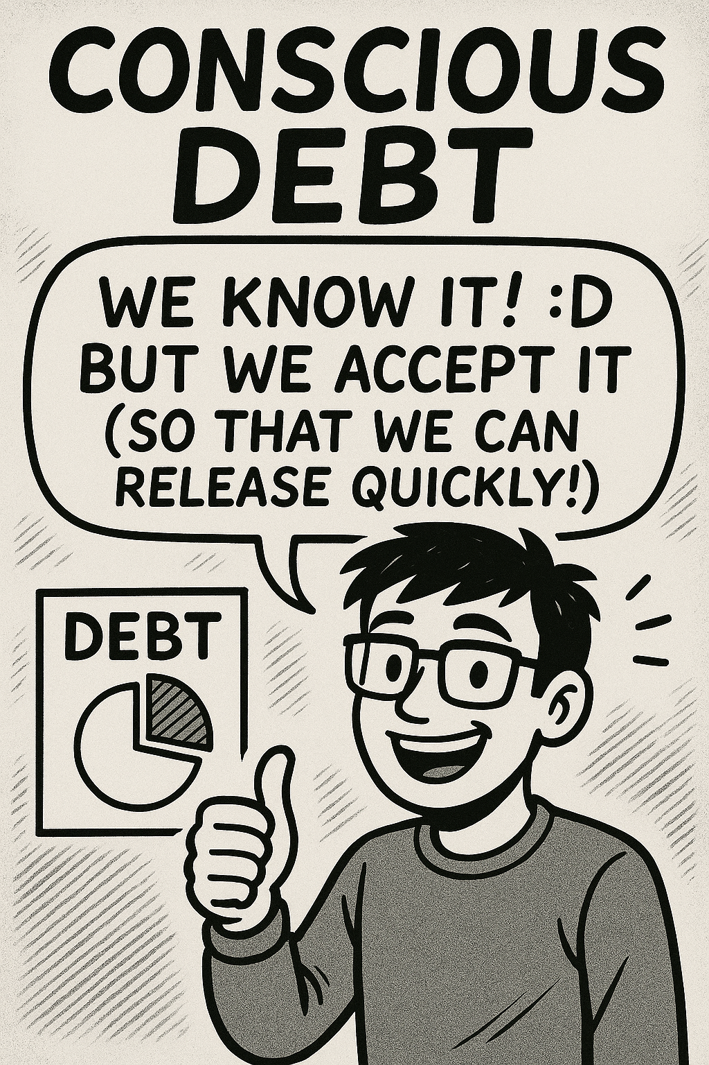
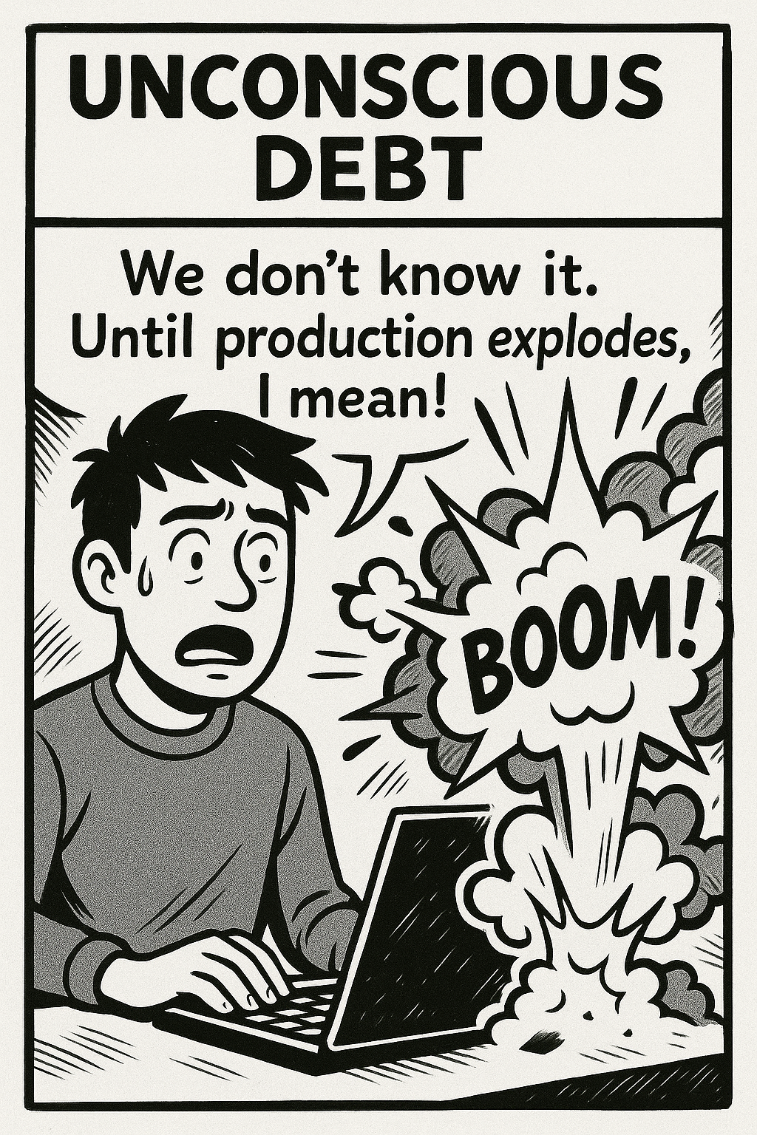
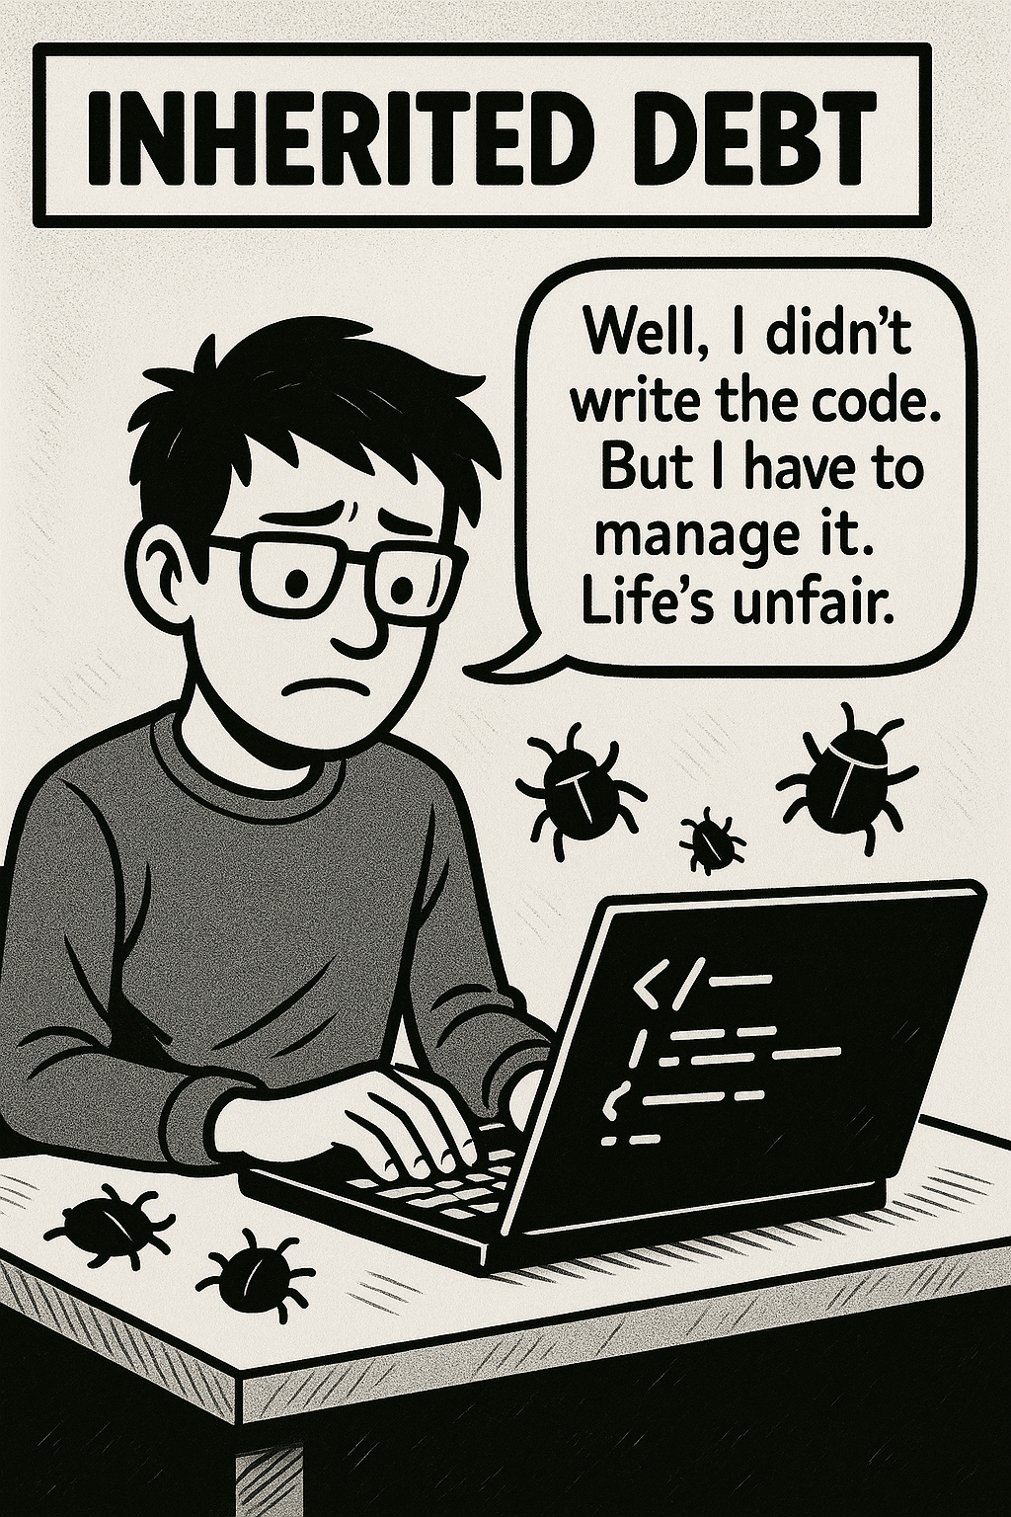
Three kinds of debt
Spoiler: We ALL have all of them.

Slide 14
Practical advice you don’t expect: DON’T AVOID TECH DEBT! ;)

Slide 15
( but manage it )
Like in financial world, “good” debt can speed things up!
The point is having the right mindset and strategy to manage it constantly
Tech debt must be understood.
Maybe it’s just a signal your system is actually evolving into something new.

Slide 16
A journey into Jointly Tech.
How we embraced Tech Debt.

Slide 17
Guidelines for this talk.
Look for this emoji: 👉.
Don’t think our solutions will work the same for you.
Remember: People make mistakes. We also do.
Generally speaking: Context is king.
This talk is mostly improvised.
A lot of content. Sorry for the headache.

Slide 18
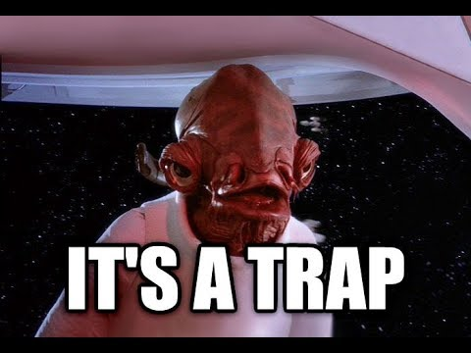
October, 2022 - The expectations.
Joined to build a modern, Node.js-React oriented team.
Team expansion: 3 to 7 people in three months.
Modernization: Bring scalability, freshness and flexibility.
Architecture improvements and innovative projects.
Move from the monoliths to modern services.

Slide 19

October, 2022 - The reality.
Pressure from everywhere to deliver “something working”.
One person full-time on bugs resolution.
Story Points per Sprint on bugs: 40%.
Locked into monolithic development.

Slide 20
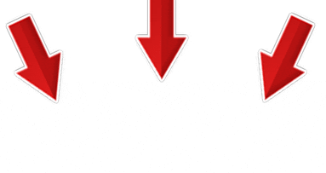
Ok, let’s focus on
one thing at a time.
👉 Do not bring 12 different methodologies together.

Slide 21

Documentation.
Because devs LOVE writing documentation, am I right?

Slide 22
Software Architecture.
Let’s try to learn something from people
really fixing those problems.

Slide 23

And then, we realized.
Software Architecture
❤️
Documentation
=
ADR

Slide 24
👉 Technical Debt Records.
Context and Problem Statement
A seguito di numerose segnalazioni sul refresh della password, abbiamo sviluppato un fix per far funzionare una procedura che non funzionava da parecchio tempo, ma il token che viene passato è prevedibile in quanto un md5 con nome, cognome, email e CF.
Considered Options
Utilizzare le signed-url invece che l’invio di un URL con token prevedibile
Outcome
Migliorare la sicurezza rendendo non prevedibile il token del refresh password
Because.. Why not?

Slide 25
But that wasn’t enough.
Documentation without action is useless.

Slide 26
TCQ.
Don’t like the name? Come here and speak up! 😡

Slide 27
Transparency.
Recognize what follows:
No one has time for features.
A good idea can become bad if the scenario changes.
Tech Debt is not guilt, it just happens.
Sometimes, Tech Debt is necessary.
I wrote the first 16 tech debts, 5 of them based on my own code.
👉 Be honest and transparent about things not working, even if that could hurt someone’s feelings.
Be the first to step in.

Slide 28
Culture.
As soon as we brought transparency in the process, day after day something magic started happening:
When adding new debt, people started solving previous ones. It became a duty to keep the list cleaner.
The right people started shining and fostering this culture.
👉 Bring makers into the team, stay away from 🐵 code monkeys.
The others must follow and walk with you.

Slide 29
Quality.
As we started noticing this culture, we decided to track down what was really happening on a data basis:
Bugs started falling down.
People started building things.
The migration to Node.js finally started.
👉 Never assume an action works (or doesn’t) just based on sentiment. Bring evidence and adjust future actions based on data.
Bring data to the table.

Slide 30
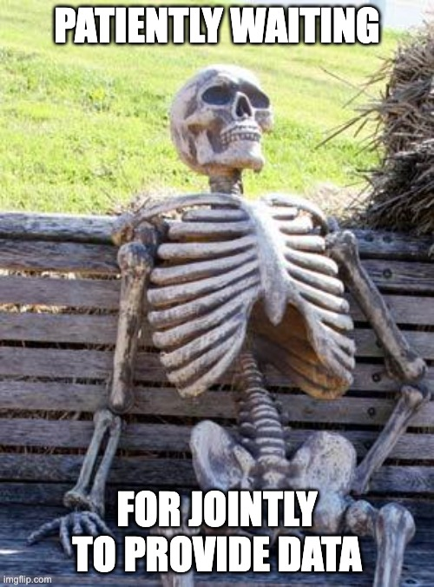
“Yeah, right, but where’s the data?”
🫷Wait, come on, give me a sec.

Slide 31
How to read the next slides.
🔴 Red line is tech debt being accumulated.
🔵 Blue line is tech debt being solved.
Or better said.. I’m so bad at presentations I need to explain myself multiple times.

Slide 32
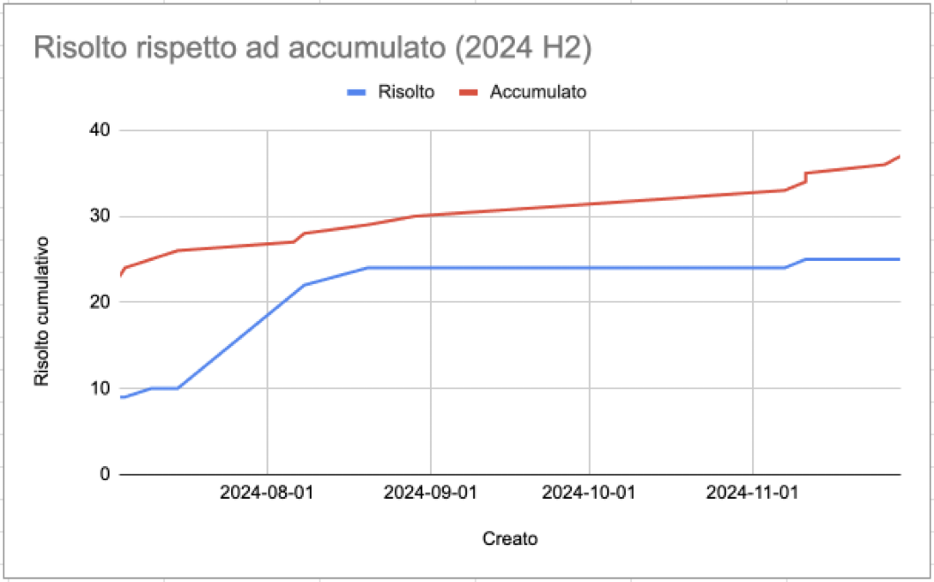
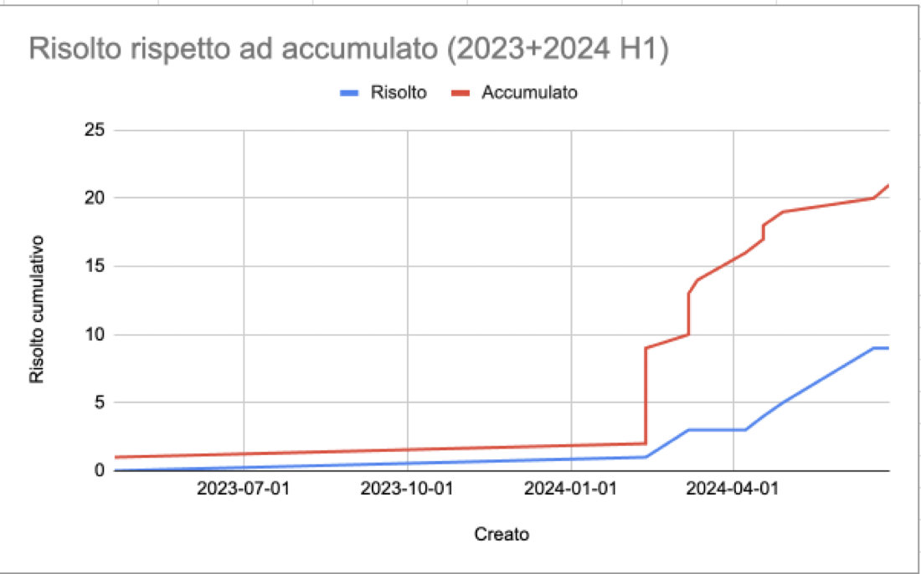
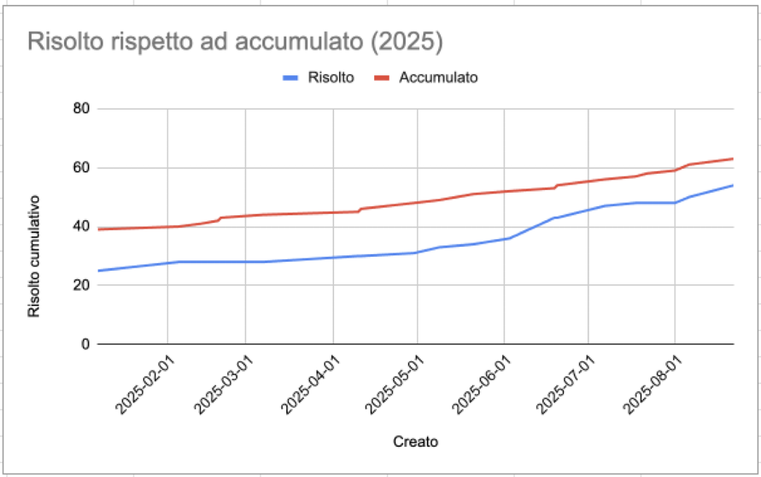
2023 + 2024 H1
2024 H2
2025

Slide 33
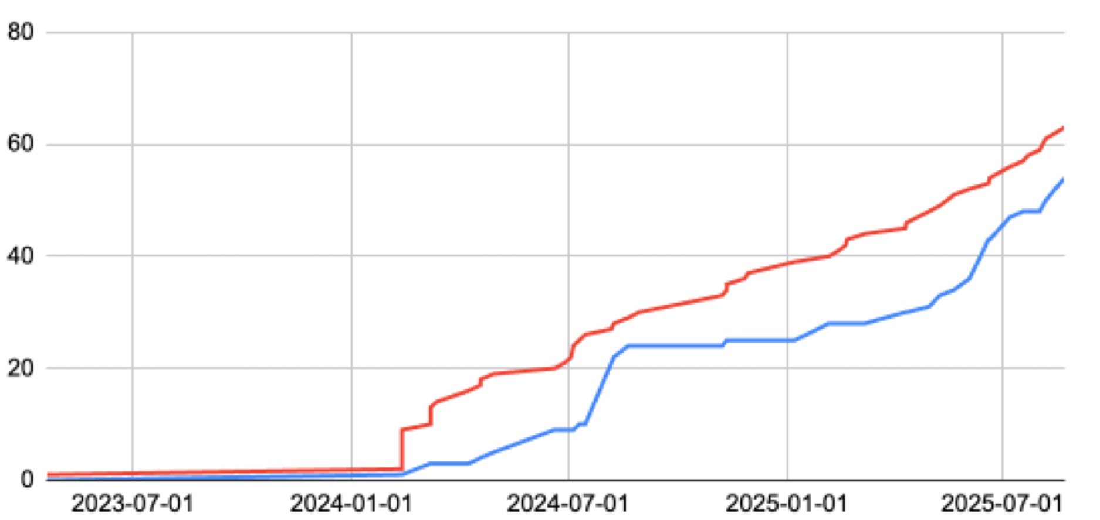

Slide 34
And, if that wasn’t enough…

Slide 35
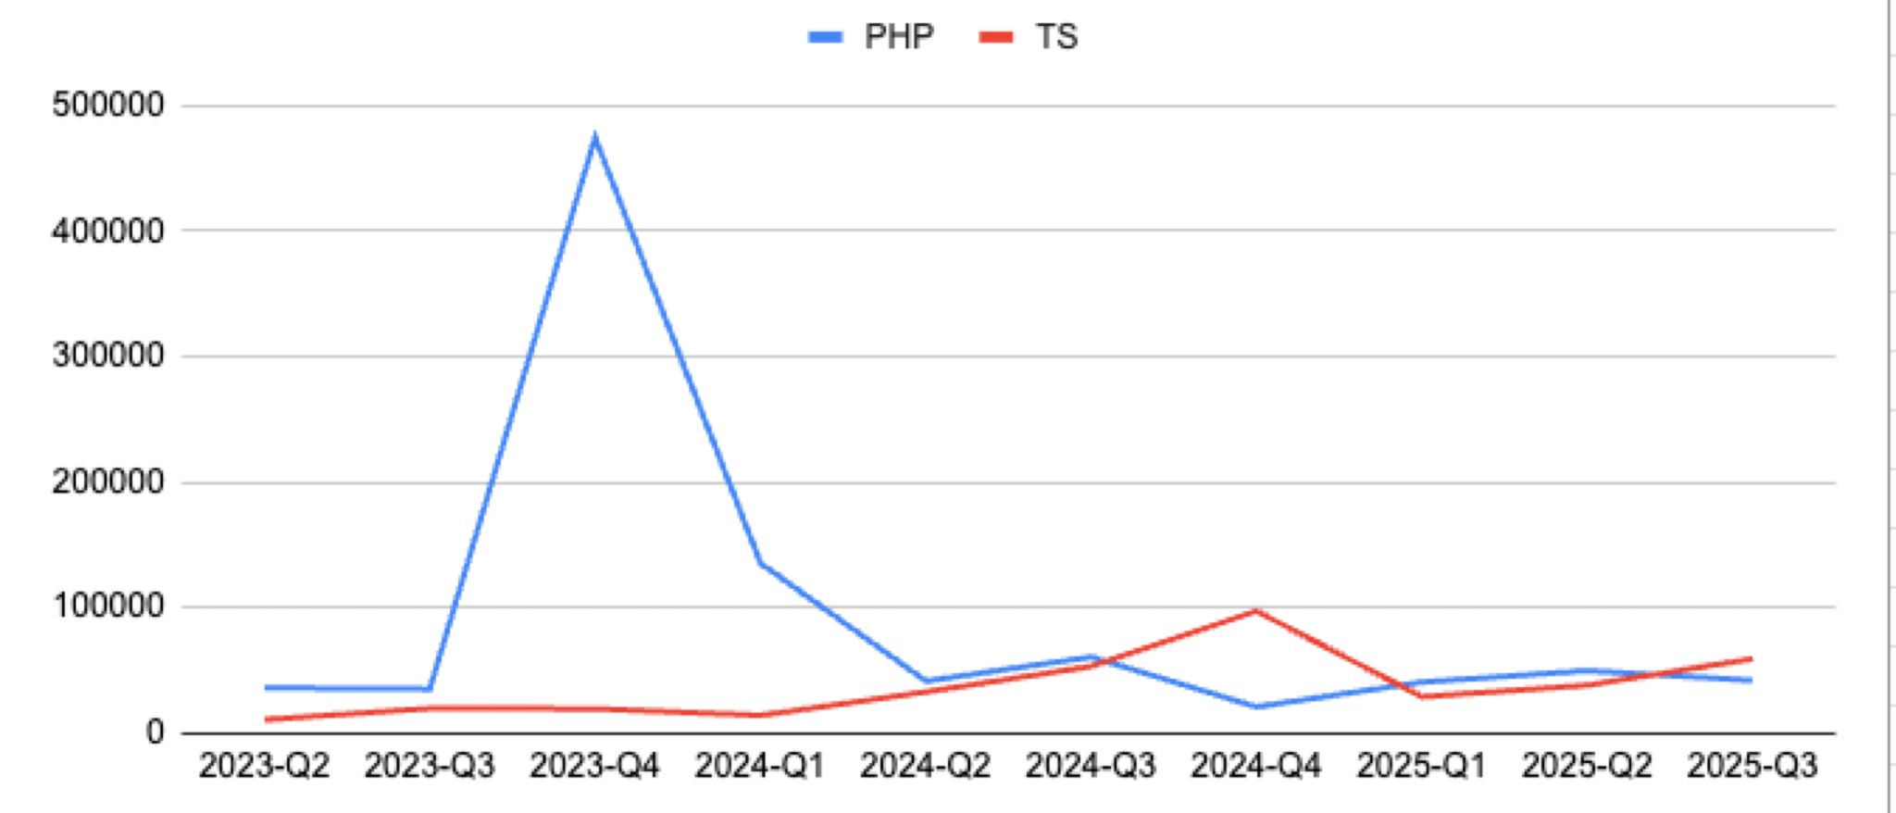

Slide 36

Meanwhile, Claude arrived.
We used Claude Sonnet 4 as a junior-mid dev to solve technical debt.
More documentation, more GenAI. We joined a virtuous cycle.
Refactoring, improving build tools, implementing specific user stories has become a small, continuously improving thing being done by GenAI.
👉 Stop doing Prompt Engineering, start doing Context Engineering.
👉 Experiment with prompts and context, don’t stop at the first failure.

Slide 37
How we use AI today, and tomorrow.
Today, we already use it for:
PR Automatic Reviews (Thanks Copilot).
PR Security Checks (Thanks Aikido).
PR PII Logs Check.
PR Redirector Check.
Event-Driven Architecture consultant.
Developing repetitive parts (database migrations, simple views, back-office forms).
Standardizing features: If two parts of the codebase have similar meaning but different code lines, bring them together.
We are starting to experiment:
Automatic test writing.
Continuous refactoring.
Continuous updater (Node, PHP, etc.)
Architecture reviewer.
Monolithic splitter.
Who knows..?
Going to Codemotion and ask people at our booth how THEY are using GenAI 👀.

Slide 38
Recap of Practical Tips

Slide 39
Recap of Practical Tips
Don’t avoid Tech Debt

Slide 40
Recap of Practical Tips
Don’t avoid Tech Debt (but be sure to manage it)

Slide 41
Recap of Practical Tips
Don’t avoid Tech Debt (but be sure to manage it)
Turn Unconscious and Inherited into Conscious Debt

Slide 42
Recap of Practical Tips
Don’t avoid Tech Debt (but be sure to manage it)
Turn Unconscious and Inherited into Conscious Debt
Experiment, but…

Slide 43
Recap of Practical Tips
Don’t avoid Tech Debt (but be sure to manage it)
Turn Unconscious and Inherited into Conscious Debt
Experiment, but… One

Slide 44
Recap of Practical Tips
Don’t avoid Tech Debt (but be sure to manage it)
Turn Unconscious and Inherited into Conscious Debt
Experiment, but… One thing

Slide 45
Recap of Practical Tips
Don’t avoid Tech Debt (but be sure to manage it)
Turn Unconscious and Inherited into Conscious Debt
Experiment, but… One thing at

Slide 46
Recap of Practical Tips
Don’t avoid Tech Debt (but be sure to manage it)
Turn Unconscious and Inherited into Conscious Debt
Experiment, but… One thing at a

Slide 47
Recap of Practical Tips
Don’t avoid Tech Debt (but be sure to manage it)
Turn Unconscious and Inherited into Conscious Debt
Experiment, but… One thing at a time!

Slide 48
Recap of Practical Tips
Don’t avoid Tech Debt (but be sure to manage it)
Turn Unconscious and Inherited into Conscious Debt
Experiment, but… One thing at a time!
Find inspiration in documentation practices…

Slide 49
Recap of Practical Tips
Don’t avoid Tech Debt (but be sure to manage it)
Turn Unconscious and Inherited into Conscious Debt
Experiment, but… One thing at a time!
Find inspiration in documentation practices…
… and discover your own! (e.g., ADR → TDR)

Slide 50
Recap of Practical Tips
Don’t avoid Tech Debt (but be sure to manage it)
Turn Unconscious and Inherited into Conscious Debt
Experiment, but… One thing at a time!
Find inspiration in documentation practices…
… and discover your own! (e.g., ADR → TDR)
Ensure you turn your records into actions

Slide 51
Recap of Practical Tips
Don’t avoid Tech Debt (but be sure to manage it)
Turn Unconscious and Inherited into Conscious Debt
Experiment, but… One thing at a time!
Find inspiration in documentation practices…
… and discover your own! (e.g., ADR → TDR)
Ensure you turn your records into actions
Be honest and transparent about Tech Debt, it’s not a shame

Slide 52
Recap of Practical Tips
Don’t avoid Tech Debt (but be sure to manage it)
Turn Unconscious and Inherited into Conscious Debt
Experiment, but… One thing at a time!
Find inspiration in documentation practices…
… and discover your own! (e.g., ADR → TDR)
Ensure you turn your records into actions
Be honest and transparent about Tech Debt, it’s not a shame
Instill “Tech Debt Management” into Team Culture

Slide 53
Recap of Practical Tips
Don’t avoid Tech Debt (but be sure to manage it)
Turn Unconscious and Inherited into Conscious Debt
Experiment, but… One thing at a time!
Find inspiration in documentation practices…
… and discover your own! (e.g., ADR → TDR)
Ensure you turn your records into actions
Be honest and transparent about Tech Debt, it’s not a shame
Instill “Tech Debt Management” into Team Culture
Although not trivial, track. Turn sentiment into data

Slide 54
Recap of Practical Tips
Don’t avoid Tech Debt (but be sure to manage it)
Turn Unconscious and Inherited into Conscious Debt
Experiment, but… One thing at a time!
Find inspiration in documentation practices…
… and discover your own! (e.g., ADR → TDR)
Ensure you turn your records into actions
Be honest and transparent about Tech Debt, it’s not a shame
Instill “Tech Debt Management” into Team Culture
Although not trivial, track. Turn sentiment into data
REMEMBER:
This is what’s working for us, in this specific moment of time.
Feel free to apply whatever you like, but discover what works for you.

Slide 55
Two Ideas (Food for Thought)

Slide 56
Two Ideas (Food for Thought)
1
Documentation is Evil.
Ask yourself WHY

Slide 57
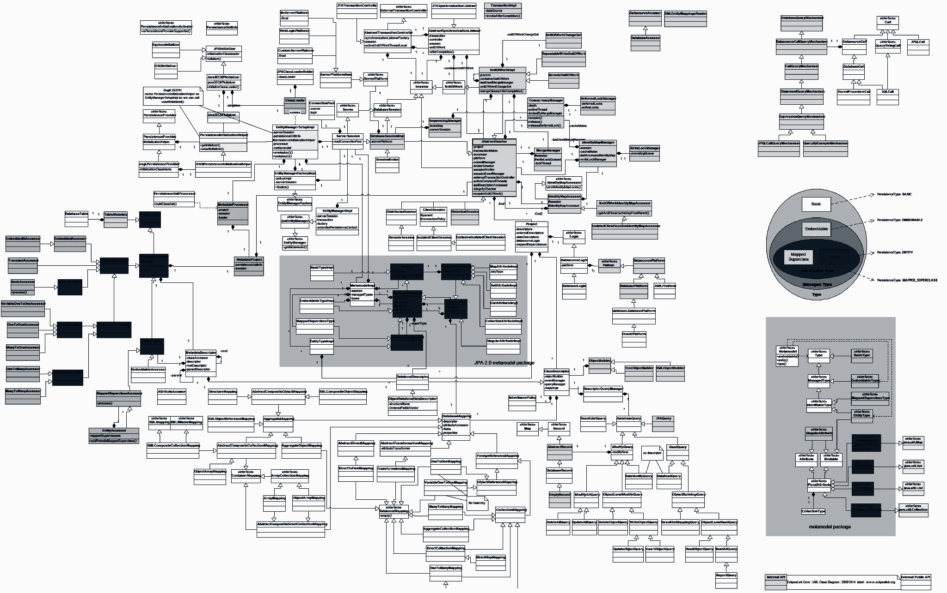
Two Ideas (Food for Thought)
1
Documentation is Evil.
Ask yourself WHY

Slide 58
Two Ideas (Food for Thought)
1
Documentation is Evil.
Ask yourself WHY
IS IT REALLY
PROVIDING VALUE?

Slide 59
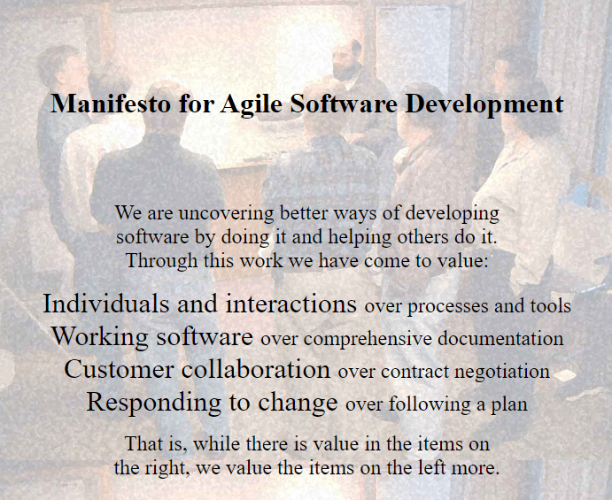
Two Ideas (Food for Thought)
1
2
Documentation is Evil.
Working software over comprehensive documentation
Ask yourself WHY
IS IT REALLY
PROVIDING VALUE?

Slide 60
Two Ideas (Food for Thought)
1
2
Documentation is Evil.
Working software over comprehensive documentation
Ask yourself WHY
IS IT REALLY
PROVIDING VALUE?
LET’S BRING AI INTO THE EQUATION

Slide 61




Let’s get in touch!
Enrico Maria Cestari
CTO @Jointly
Michael Di Prisco
Tech Lead @ Jointly
linkedin.com/in/emcestari/
linkedin.com/in/mdiprisco/
emcestari
Lol, I’m not a boomer.

Slide 62

Don't forget to rate the talk!

